Slide 1

Pharmacotherapy of
Arrhythmias
Tessema Tsehay (B.Pharm., M.Pharm., RPh.)
Clinical Pharmacy and Pharmacy Practice Course Team
Department of Pharmacy, CHS, Mizan Tepi University
Email: tessema.tsehay@gmail.com

Slide 2
Introduction: The Heart
The heart has two basic properties, namely an
  Electrical property
  Mechanical property
Electrical activity is initiated by the sinoatrial (SA) node and moves through cardiac tissue by a tree-like conduction network.
The SA node initiates cardiac rhythm under normal circumstances because this tissue possesses the highest degree of automaticity or rate of spontaneous impulse generation.

Slide 3
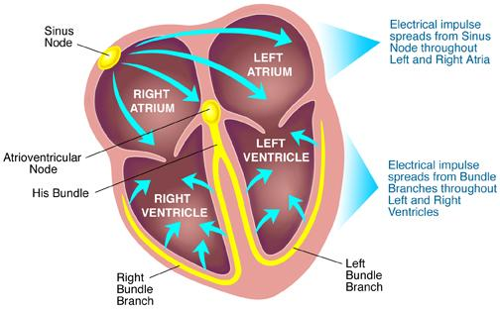

Slide 4
Characteristics of Cardiac Muscle
Automaticity
  ability to generate an electrical impulse spontaneously & repetitively
Excitability
  ability to be electrically stimulated or respond to an electrical stimulus
Conductivity
  ability to receive an electrical stimulus and transmit to other cardiac cells
Contractility/rhythmicity
  the ability to shorten and cause contraction in response to an electrical stimulus-coordination of contraction to produce a regular heartbeat

Slide 5
Cont…
Automaticity
SA nodal cells: Highest intrinsic rate, primary pacemaker of the heart (100-120/min)
AV nodal cell: Second highest intrinsic rate, secondary pacemaker of the heart (40-60/min)
Purkinje cells: Slowest intrinsic rate (30-40/min)

Slide 6
Cont…
Electrical Conduction System of the Heart
  The heart is supplied with an electrical conduction system that generates and conducts electrical impulses along specialized pathways.
  Normal conduction pathway
    SA node internodal pathway AV node bundle of His Left and Right Bundle Branches purkinji fibers

Slide 7
Action potential
Momentary change in the electrical charge stored on the surface of a cell.
It is a cyclic of depolarization and repolarization
Resting state - K⁺ inside and Na⁺ outside cell (Na⁺/K⁺ pump)
AP occurs when Na⁺ enters the cell and sets up a depolarising current

Slide 8
Phases of Action Potential
The action potential can be described in five phases.
Phase 0
  rapid depolarization in response to influx of sodium ions
  determines the velocity of impulse conduction
  Drugs that decrease the rate of phase 0 depolarization (by blocking sodium channels)
    slow impulse conduction though the His-Purkinje system and myocardium
Phase 1
  rapid (but partial) repolarization takes place
  has no relevance to antidysrhythmic drugs

Slide 9
Cont…
Phase 2
  consists of a prolonged plateau in which the membrane potential remains relatively stable
  calcium enters the cell and promotes contraction of atrial and ventricular muscle
  Drugs that reduce calcium entry during phase 2 do not influence cardiac rhythm
    can reduce myocardial contractility

Slide 10
Cont…
Phase 3
  rapid repolarization takes place
  extrusion of potassium from the cell
  relevant in that delay of repolarization prolongs the action potential duration, and
  thereby prolongs the effective refractory period (ERP)
  ERP is the time during which a cell is unable to respond to excitation and initiate a new action potential
Phase 4
  two types of electrical activity are possible:
    the membrane potential may remain stable or
    the membrane may undergo spontaneous depolarization

Slide 11
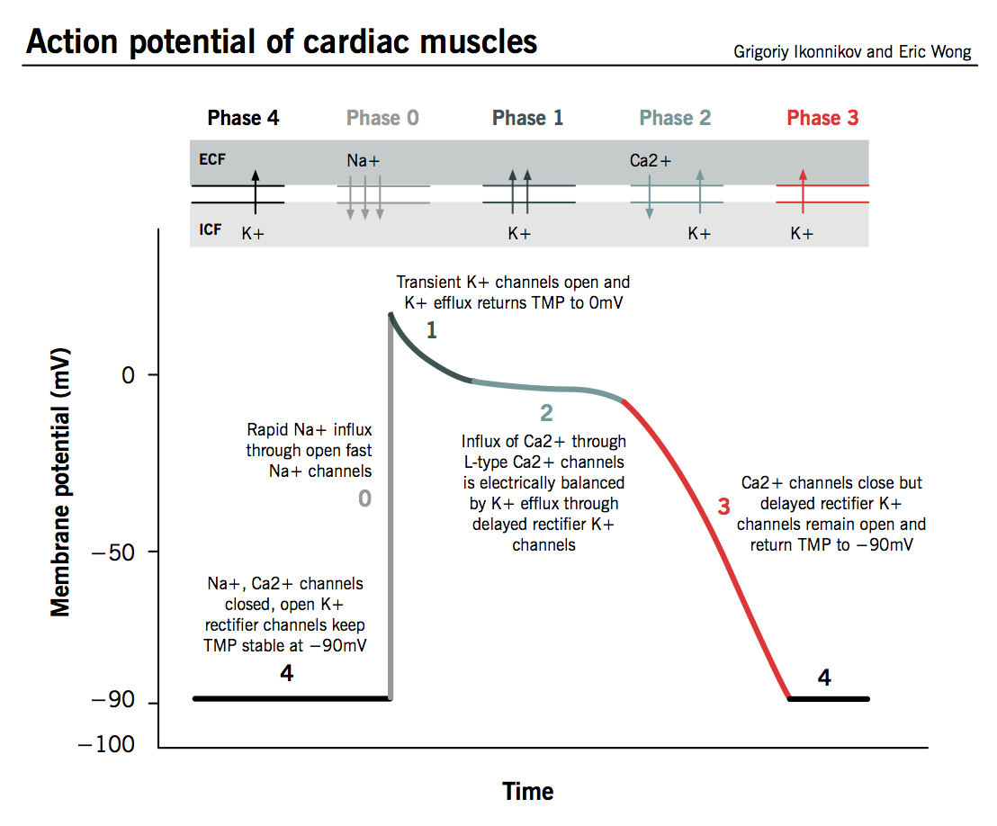
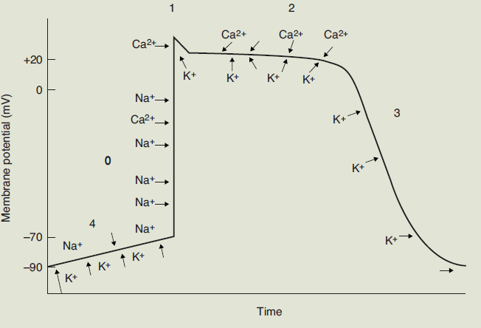
Cont...

Slide 12
Cont…
ECG
  A recording of the electrical activity of the heart over time.
  is a non-invasive means of measuring the electrical activity of the heart.
  Gold standard for diagnosis of cardiac arrhythmias
  Net sum of depolarisation and repolarisation potentials of all myocardial cells
  P-QRS-T pattern

Slide 13
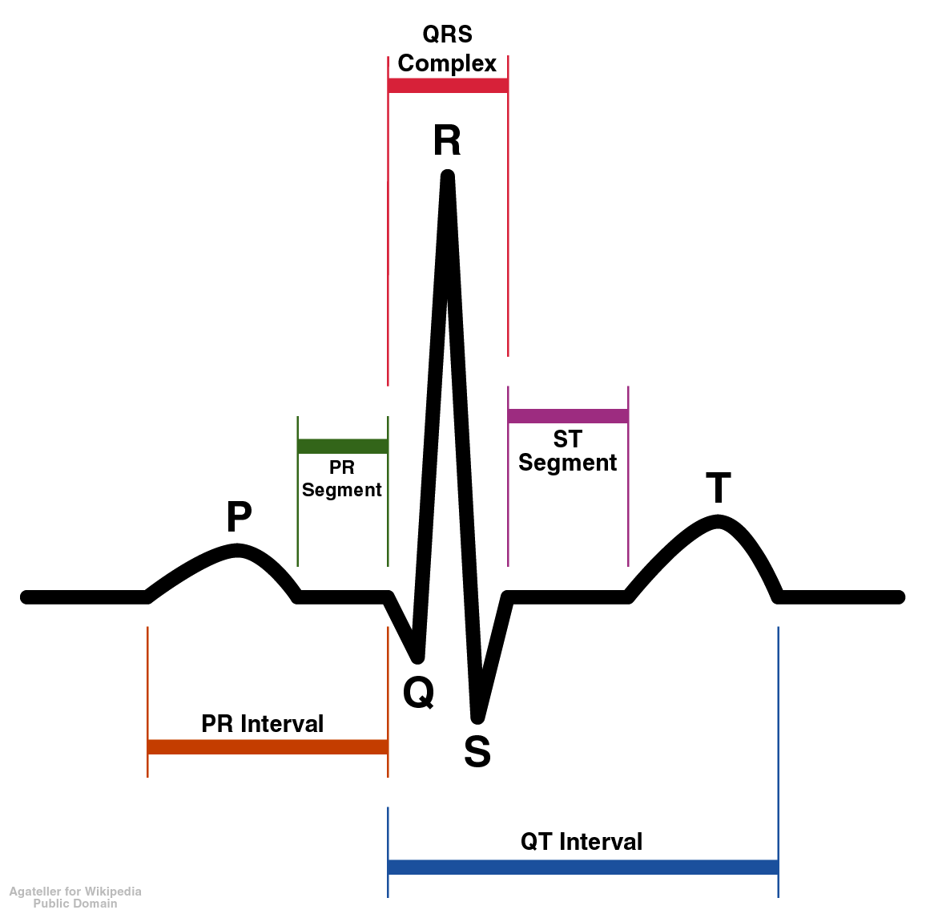
Dx of ventricular hypertrophy, MI, electrolyte derangement
Shape and duration of P may indicate atrial enlargement
Contraction/dep’n of ventricles
Repolarization of ventricles
Contraction of atria
-absolute refractory period
-Varies based on HR
Atria to Vent. Conduction time
Prolonged PR shows AV block

Slide 14
Definition
An abnormality of the cardiac rhythm: rate and regularity
Arrhythmias may cause sudden death, syncope, heart failure, dizziness, palpitations or no symptoms at all.
In general, cardiac arrhythmias are classified into two broad categories:
  Supraventricular (those occurring above the ventricles)
  Ventricular (those occurring in the ventricles).
base on the hear rate:
  bradycardia: the HR is slow (< 60 b.p.m).
  tachycardia: the HR is fast (> 100 b.p.m).

Slide 15
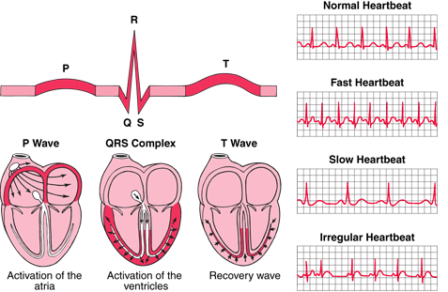

Slide 16
Mechanisms of Cardiac Arrhythmias
Mechanisms generating bradycardia
  Sinus bradycardia is a result of abnormally slow automaticity
  AV block -by abnormal conduction within the AV node or the distal AV conduction system.
Mechanisms generating tachycardia
  Accelerated automaticity
  Triggered activity
  Re-entry (or circus movements)

Slide 17
Accelerated automaticity
It occurs due to increasing the rate of depolarization or changing the threshold potential.
Such changes are thought to produce sinus tachycardia, escape rhythms and accelerated AV nodal (junctional) rhythms.
an increased slope of phase 4 depolarization in cardiac tissues other than the SA node due to the following drugs and conditions;
  digitalis glycosides, catecholamines , hypoxemia, electrolyte abnormalities, fiber stretch (cardiac dilation)
Notes:
The increased slope of phase 4 causes heightened automaticity of these tissues and competition with the SA node for dominance of cardiac rhythm. If the rate of spontaneous impulse generation of the abnormally automatic tissue exceeds that of the SA node, then an automatic tachycardia may result.

Slide 18
Triggered activity
Transient membrane depolarizations that occur during repolarization [EADs]) or after repolarization [LADs]) but prior to phase 4 of the AP
Presence of an increased Ca²⁺ load
EADs is by: hypokalemia/K+ blockers, type Ia antiarrhythmic drugs.
  Ex. Torsades de pointes
LADs is by: digitalis or catecholamines, ischemia and suppressed by CCBs.
  Ex. exercise-provoked VT
Notes:
EADs may be precipitated by hypokalemia, type Ia antiarrhythmic drugs, or slow stimulation rates—any factor that blocks the
ion channels (e.g., potassium) responsible for cellular repolarization.
Early after-depolarizations provoked by drugs that block potassium conductance and delay repolarization are the underlying cause of TdP. Late after-depolarizations may be precipitated by digitalis or catecholamines and suppressed by CCBs, and have been suggested as the mechanism for multifocal atrial tachycardia, digitalis-induced tachycardias and exercise-provoked VT.
In fact, potassium infusions in patients with the congenital long QT syndrome (LQTS) and in those with drug-induced acquired QT prolongation shorten the QT interval

Slide 19
Re-entry (or circus movement)
An Indefinite propagation of the impulse and continued activation of previously refractory tissue.
Reentry may occur as a consequence of anatomic or functional variants in the normal conduction system
Heart diseases (e.g., IHD, LV dysfunction) can result in changes in conduction in the pathways of a suitable reentrant substrate.
Notes:
An often-used example is reentry occurring as a consequence of ischemic or hypoxic damage: with inadequate cellular oxygen, cardiac tissue resorts to anaerobic glycolysis for ATP production. As high-energy phosphate concentration diminishes, the activity of the transmembrane ion pumps declines and RMP rises. This rise in RMP causes inactivation in the voltage-dependent sodium channel and the tissue begins to assume slow conduction characteristics. If changes in conduction parameters occur in a discordant manner due to varying degrees of ischemia or hypoxia, then a reentry circuit may become manifest.

Slide 20
Pathophysiology
Supraventricular Arrhythmias
Common supraventricular tachycardias requiring drug treatment are
  atrial fibrillation (AF) or atrial flutter
  paroxysmal supraventricular tachycardia (PSVT) and
  automatic atrial tachycardias
Other common supraventricular arrhythmias that usually do not require drug therapy are
  premature atrial complexes
  wandering atrial pace-maker
  sinus arrhythmia
  sinus tachycardia

Slide 21
Atrial Fibrillation and Atrial Flutter
AF
  is characterized as an extremely rapid (400 to 600 atrial beats/min) and disorganized atrial activation.
  There is a loss of atrial contraction (atrial kick) and
  supraventricular impulses penetrate the atrioventricular (AV) conduction system in variable degrees,
    resulting in irregular ventricular activation and irregularly irregular pulse (120 to 180 beats/min).

Slide 22
Cont…
Atrial flutter
  is characterized by rapid (270 to 330 atrial beats/min) but regular atrial activation.
  The ventricular response usually has a regular pattern and a pulse of 300 beats/min.
  This arrhythmia occurs less frequently than AF but
    has similar precipitating factors, consequences, and drug therapy.

Slide 23
Cont…
The predominant mechanism of AF and atrial flutter is reentry,
  which is usually associated with organic heart disease that causes atrial distention (e.g., ischemia or infarction, hypertensive heart disease, valvular disorders).
  Additional associated disorders include
    acute pulmonary embolus and chronic lung disease, resulting in pulmonary hypertension and cor pulmonale and
    states of high adrenergic tone such as thyrotoxicosis, alcohol withdrawal, sepsis or excessive physical exertion

Slide 24
PSVT
Caused by Reentry
PSVT arising by reentrant mechanisms includes arrhythmias caused by
  AV nodal reentry
  AV reentry incorporating an anomalous AV pathway
  sinoatrial (SA) nodal reentry and
  intraatrial reentry

Slide 25
Automatic Atrial Tachycardias
Automatic atrial tachycardias such as multifocal atrial tachycardia appear to arise from
  supraventricular foci with enhanced automatic properties.
Severe pulmonary disease is the underlying precipitating disorder in 60% to 80% of patients.

Slide 26
Ventricular Arrhythmias
Premature Ventricular Complexes (PCVs)
  are common ventricular rhythm disturbances that occur in patients with or without heart disease and may be elicited experimentally by
    abnormal automaticity
    triggered activity or
    reentrant mechanisms

Slide 27
Cont…
Ventricular tachycardia (VT)
  defined by three or more repetitive PVCs occurring at a rate greater than 100 beats/min
  It occurs most commonly in acute myocardial infarction (MI)
  other causes are severe electrolyte abnormalities (e.g., hypokalemia), hypoxemia and digitalis toxicity
  The chronic recurrent form is almost always associated with underlying organic heart disease
    e.g., idiopathic dilated cardiomyopathy or remote MI with left ventricular aneurysm

Slide 28
Cont…
Sustained VT : which requires therapeutic intervention to restore a stable rhythm
Non-sustained VT : self-terminates after a brief duration (usually less than 30 seconds).
Incessant VT : refers to VT occurring more frequently than sinus rhythm, so that VT becomes the dominant rhythm.
Monomorphic VT : has a consistent QRS configuration
Polymorphic VT : has varying QRS complexes.
Torsade de pointes (TdP) : is a polymorphic VT in which the QRS complexes appear to undulate around a central axis.

Slide 29
Ventricular Proarrhythmia
Proarrhythmia refers to development of a significant new arrhythmia such as VT, ventricular fibrillation [VF] or TdP) or worsening of an existing arrhythmia.
Proarrhythmia results from the same mechanisms that cause other arrhythmias or due to the antiarrhythmic agent.

Slide 30
Ventricular Fibrillation
VF is electrical anarchy of the ventricle resulting in no cardiac output and cardiovascular collapse.
Sudden cardiac death occurs most commonly in patients with IHD and primary myocardial disease associated with LV dysfunction.
VF associated with acute MI may be classified as either
  primary (an uncomplicated MI not associated with HF or
  secondary or complicated (an MI complicated by HF)

Slide 31
Bradyarrhythmias
Asymptomatic sinus bradyarrhythmias
  (heart rate less than 60 beats/min) are common especially in young, athletically active individuals.
  However, some patients have sinus node dysfunction (sick sinus syndrome) because of underlying organic heart disease and the normal aging process, which attenuates SA nodal function.

Slide 32
Cont…
Sinus node dysfunction is usually representative of diffuse conduction disease,
  which may be accompanied by AV block AF.
Alternating bradyarrhythmias and tachyarrhythmias are referred to as the tachy-brady syndrome.

Slide 33
Cont…
AV block or conduction delay may occur in any area of the AV conduction system.
AV block may be found in patients without underlying heart disease (e.g., trained athletes) or during sleep when vagal tone is high.
It may be transient when the underlying etiology is reversible
  e.g., myocarditis, myocardial ischemia, after cardiovascular surgery, during drug therapy

Slide 34
Cont…
β -Blockers, digoxin, or nondihydropyridine calcium antagonists may cause AV block, primarily in the AV nodal area.
Type I antiarrhythmics may exacerbate conduction delays below the level of the AV node.
AV block may be irreversible if the cause is
  acute MI
  rare degenerative disease
  primary myocardial disease or
  a congenital condition

Slide 35
Clinical Presentations
Supraventricular tachycardias may cause a variety of clinical manifestations ranging from
  no symptoms to minor palpitations and/or irregular pulse to
  severe and even life-threatening symptoms.
Patients may experience
  dizziness or acute syncopal episodes
  symptoms of HF
  anginal chest pain or
  more often a choking or pressure sensation during the tachycardia episode

Slide 36
Cont…
AF or atrial flutter
  may be manifested by the entire range of symptoms associated with other supraventricular tachycardias,
    but syncope is not a common presenting symptom.
  An additional complication of AF is arterial embolization resulting from atrial stasis and poorly adherent mural thrombi,
    which accounts for the most devastating complication: embolic stroke.
  Patients with AF and concurrent mitral stenosis or severe systolic HF are at particularly high risk for cerebral embolism.

Slide 37
Cont…
PVCs
  often cause no symptoms or only mild palpitations.
VT
  The presentation of VT may vary from totally asymptomatic to pulseless hemodynamic collapse.
proarrhythmia
  Consequences of proarrhythmia range from no symptoms to worsening of symptoms to sudden death.
VF
  results in hemodynamic collapse, syncope, and cardiac arrest

Slide 38
Cont…
bradyarrhythmias
  Patients with bradyarrhythmias experience symptoms associated with
    hypotension such as dizziness, syncope, fatigue, and confusion.
  If LV dysfunction exists, symptoms of congestive HF may be exacerbated.

Slide 39
Diagnosis
The surface electrocardiogram (ECG) is the cornerstone of diagnosis for cardiac rhythm disturbances.
Less sophisticated methods are often the initial tools for detecting qualitative and quantitative alterations of heartbeat.
  For example, direct auscultation can reveal the irregularly irregular pulse that is characteristic of AF.
Proarrhythmia can be difficult to diagnose because of the variable nature of underlying arrhythmias.
TdP is characterized by long QT intervals or prominent U waves on the surface ECG.

Slide 40
Desired Outcome
The desired outcome depends on the underlying arrhythmia.
For example, the ultimate treatment goals of treating AF or atrial flutter are
  restoring sinus rhythm
  preventing thromboembolic complications and
  preventing further recurrences

Slide 41
Treatment
General Approach
The use of antiarrhythmic drugs in the United States is declining because of major trials that showed
  increased mortality
  proarrhythmia as a significant side effect
  the advancing technology of nondrug therapies such as ablation and the implantable cardioverter-defibrillator (ICD)

Slide 42
Classification of Antiarrhythmic Drugs
Drugs may have antiarrhythmic activity by directly altering conduction in several ways.
  may depress the automatic properties of abnormal pacemaker cells
    by decreasing the slope of phase 4 depolarization and/or by elevating threshold potential.
  may alter the conduction characteristics of the pathways of a reentrant loop.

Slide 43
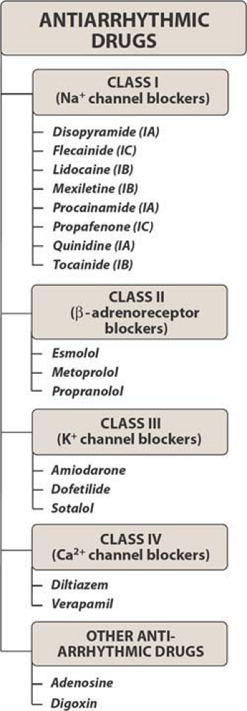
Notes:
Mechanisms of Anti-Arrhythmic Drug Action
Drugs may slow automatic rhythms by altering any of the four determinants of spontaneous pacemaker discharge:
decrease phase 4 slope
increase threshold potential
increase maximum diastolic potential
increase APD

Slide 44
Cont…
The most frequently used classification system is that proposed by Vaughan Williams.
Type Ia drugs
  slow conduction velocity
  prolong refractoriness and
  decrease the automatic properties of sodium-dependent (normal and diseased) conduction tissue.
  Type Ia drugs are broad-spectrum antiarrhythmics, being effective for both supraventricular and ventricular arrhythmias

Slide 45
Cont…
type Ib drugs
  Although categorized separately, type Ib drugs probably act similarly to type Ia drugs, except that type Ib agents are considerably more effective in ventricular than supraventricular arrhythmias.
Type Ic drugs
  profoundly slow conduction velocity while leaving refractoriness relatively unaltered.
  Although effective for both ventricular and supraventricular arrhythmias, their use for ventricular arrhythmias has been limited by the risk of proarrhythmia
Collectively, type I drugs can be referred to as sodium channel blockers.

Slide 46
Cont…
Type II drugs
  β-adrenergic antagonists ; clinically relevant mechanisms result from their antiadrenergic actions.
  β-Blockers are most useful in tachycardias in which nodal tissues are abnormally automatic or are a portion of a reentrant loop.
  These agents are also helpful in slowing ventricular response in atrial tachycardias (e.g., AF) by their effects on the AV node.

Slide 47
Cont…
Type III drugs
  specifically prolong refractoriness in atrial and ventricular fibers and include very different drugs that share the common effect of delaying re-polarization by blocking potassium channels.
  are effective in most supraventricular and ventricular tachycardias.

Slide 48
Cont…
Amiodarone
  impressive effectiveness and low proarrhythmic potential
  It is a sodium channel blocker
  has nonselective β-blocking actions,
  blocks potassium channels, and
  has slight calcium antagonist activity.

Slide 49
Cont…
Type IV drugs
  inhibit calcium entry into the cell, which
    slows conduction,
    prolongs refractoriness, and
    decreases SA and AV nodal automaticity.
  CCBs hence are effective for automatic or reentrant tachycardias that arise from or use the SA or AV nodes.

Slide 50
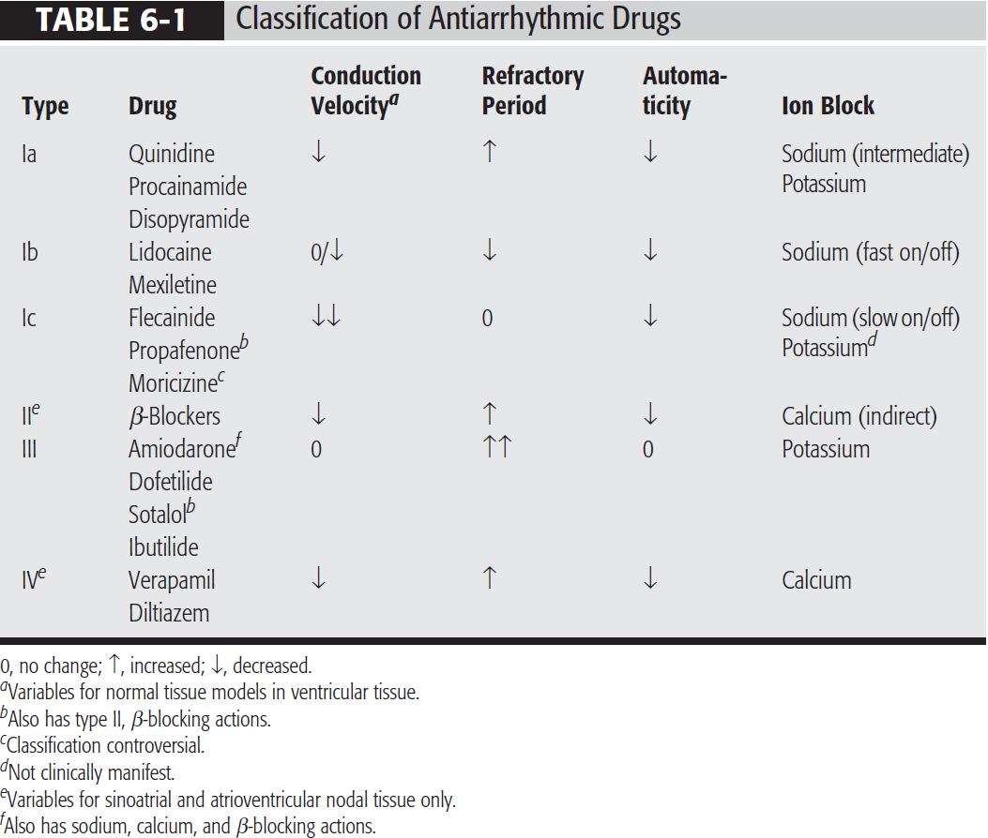
Cont…

Slide 51
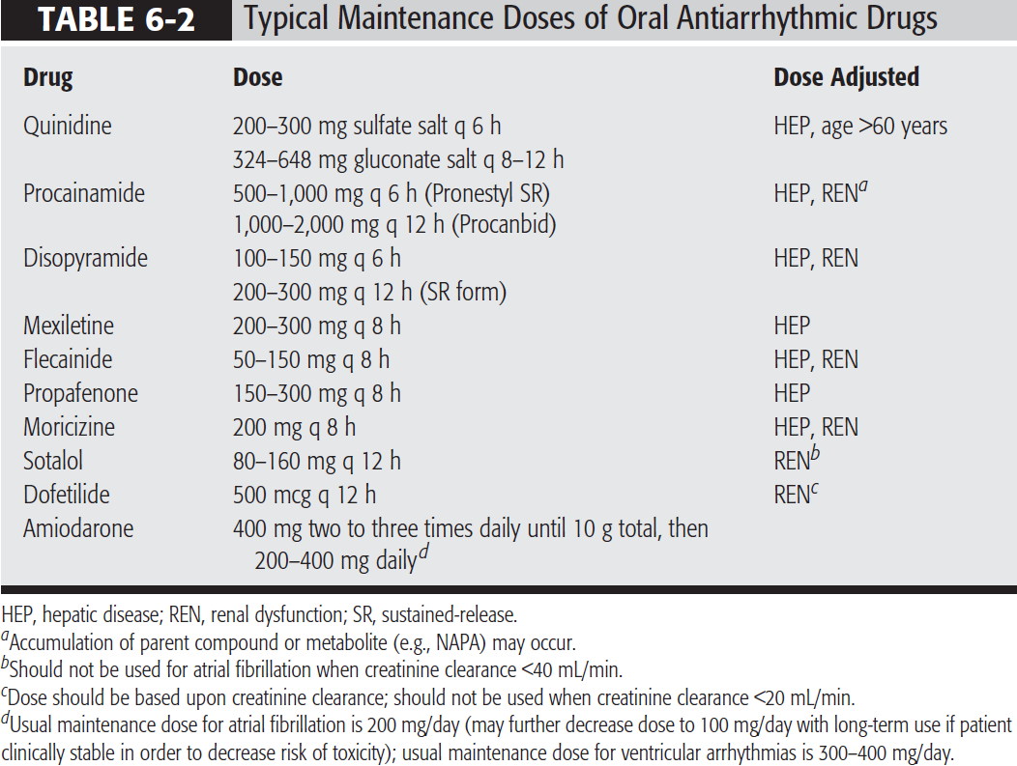

Slide 52
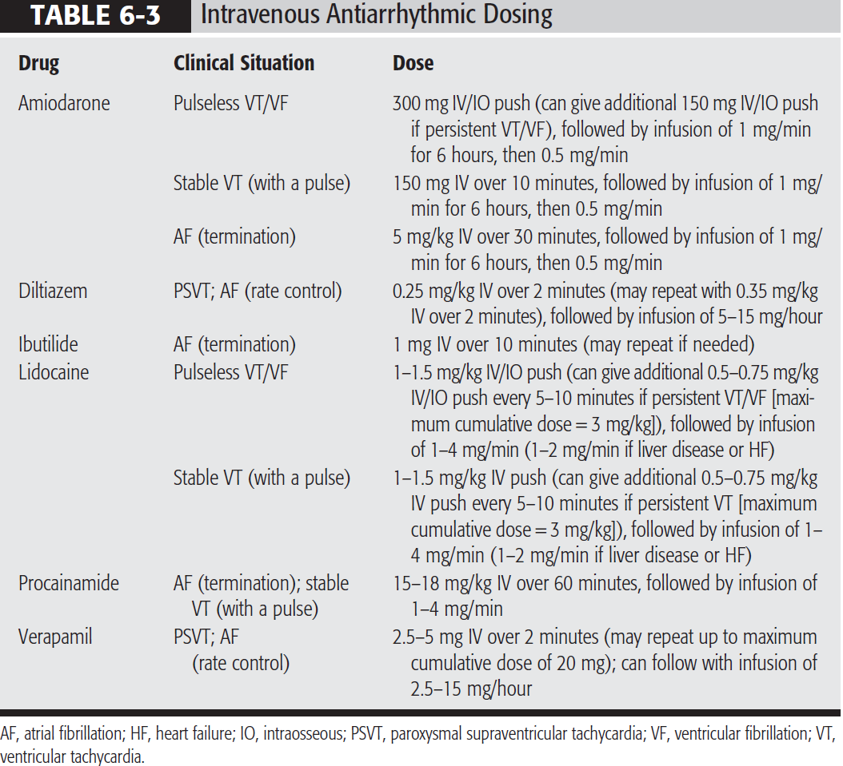

Slide 53
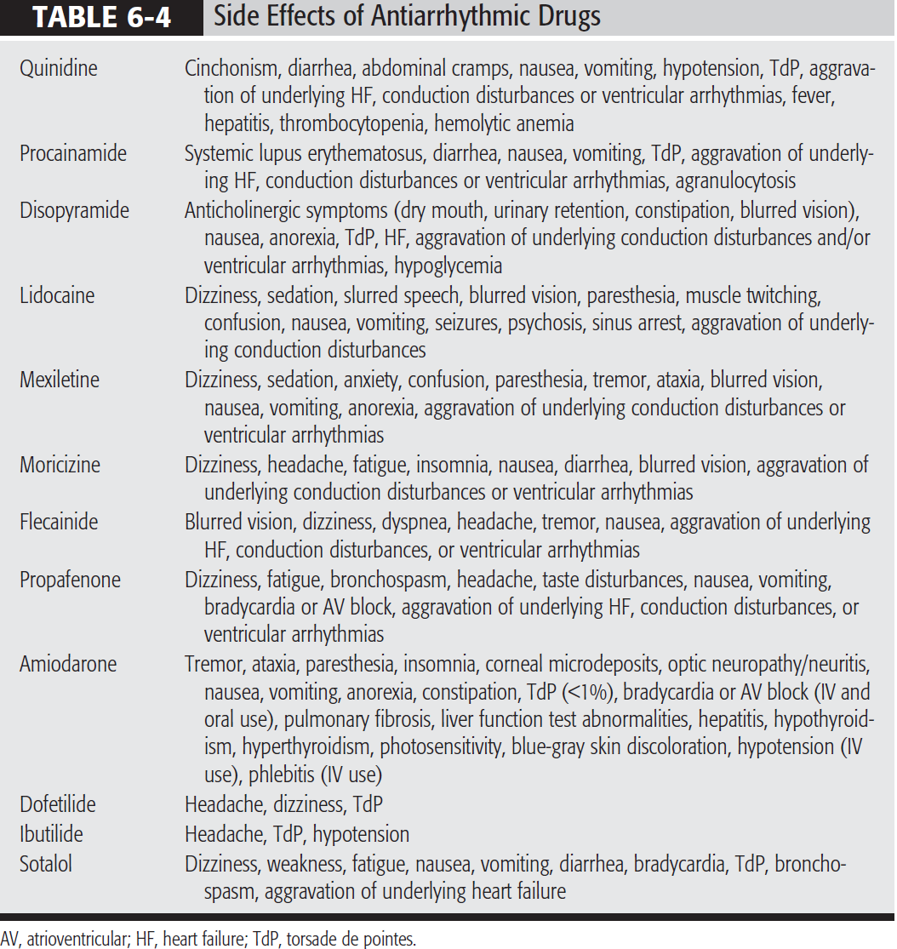

Slide 54
Treatment
Atrial Fibrillation or Atrial Flutter
Many methods are available for restoring sinus rhythm, preventing thromboembolic complications, and preventing further recurrences
  however, treatment selection depends in part on onset and severity of symptoms.
  If symptoms are severe and of recent onset, patients may require direct-current cardioversion (DCC) to restore sinus rhythm immediately

Slide 55
Cont…
If patients are hemodynamically stable, the focus should be directed toward control of ventricular rate.
  Drugs that slow conduction and increase refractoriness in the AV node should be used as initial therapy.
In patients with normal LV function (left ventricular ejection fraction >40%),
  IV β-blockers (propranolol, metoprolol, esmolol ), diltiazem or verapamil is recommended.

Slide 56
Cont…
If a high adrenergic state is the precipitating factor,
  IV β-blockers can be highly effective and should be considered first.
In patients with left ventricular ejection fraction ≤40%,
  IV diltiazem and verapamil should be avoided and IV β-blockers should be used with caution.

Slide 57
Cont…
In patients having an exacerbation of HF symptoms,
  IV digoxin or amiodarone should be used as first-line therapy for ventricular rate control.
  IV amiodarone can also be used in patients who are refractory or have contraindications to BBs, nondihydropyridine CCBs and digoxin.
After treatment with AV nodal blocking agents and a subsequent decrease in ventricular response,
  the patient should be evaluated for the possibility of restoring sinus rhythm if AF persists.

Slide 58
Cont…
If sinus rhythm is to be restored,
  anticoagulation should be initiated prior to cardioversion because return of atrial contraction increases risk of thromboembolism.
  Patients with AF for longer than 48 hours or an unknown duration should receive warfarin
    target INR 2 to 3
    for at least 3 weeks prior to cardioversion and continuing for at least 4 weeks after effective cardioversion and return of normal sinus rhythm.

Slide 59
Cont…
  Patients with AF less than 48 hours in duration do not require warfarin,
    but it is recommended that these patients receive either IV UH or a LMWH (subcutaneously at treatment doses) at presentation prior to cardioversion.
After prior anticoagulation (or after TEE demonstrated the absence of a thrombus, thereby obviating the need for warfarin)
  methods for restoring sinus rhythm in patients with AF or atrial flutter are pharmacologic cardioversion and DCC

Slide 60
Cont…
DCC is quick and more often successful, but it requires prior sedation or anesthesia and has a small risk of serious complications such as sinus arrest or ventricular arrhythmias.
Relatively strong evidence for efficacy of pharmacological cardioversion
  type III pure k blockers ( ibutilide, dofetilide ),
  type Ic drugs (e.g., flecainide, propafenone), and
  amiodarone (oral or IV).
Disadvantages of drug therapy are
  significant side effects such as drug-induced TdP,
  drug–drug interactions, and
  lower cardioversion rate for drugs compared with DCC

Slide 61
Cont…
The ACCP recommends chronic warfarin treatment (target INR 2.5; range 2 to 3) for all patients with AF who are at high risk for stroke
  rheumatic mitral valve disease
  previous ischemic stroke, transient ischemic attack, or other systemic embolic event
  age >75 years
  moderate or severe LV systolic dysfunction and/or congestive HF
  hypertension or
  prosthetic heart valve

Slide 62
Cont…
Those at intermediate risk (age 65 to 75 years with none of the high-risk factors)
  should receive either warfarin (target INR 2.5; range 2 to 3) or aspirin 325 mg/day.
Those at low risk (age <65 years with none of the high-risk factors)
  should receive aspirin 325 mg/day.
Chronic antithrombotic therapy should be considered for
  all patients with AF and risk factors for stroke regardless of whether or not they remain in sinus rhythm

Slide 63
Cont…
AF often recurs after initial cardioversion because most patients have irreversible underlying heart or lung disease.
Consequently, chronic anti-arrhythmic drugs should be reserved
  for patients with recurrent AF associated with intolerable symptoms during episodes of AF

Slide 64
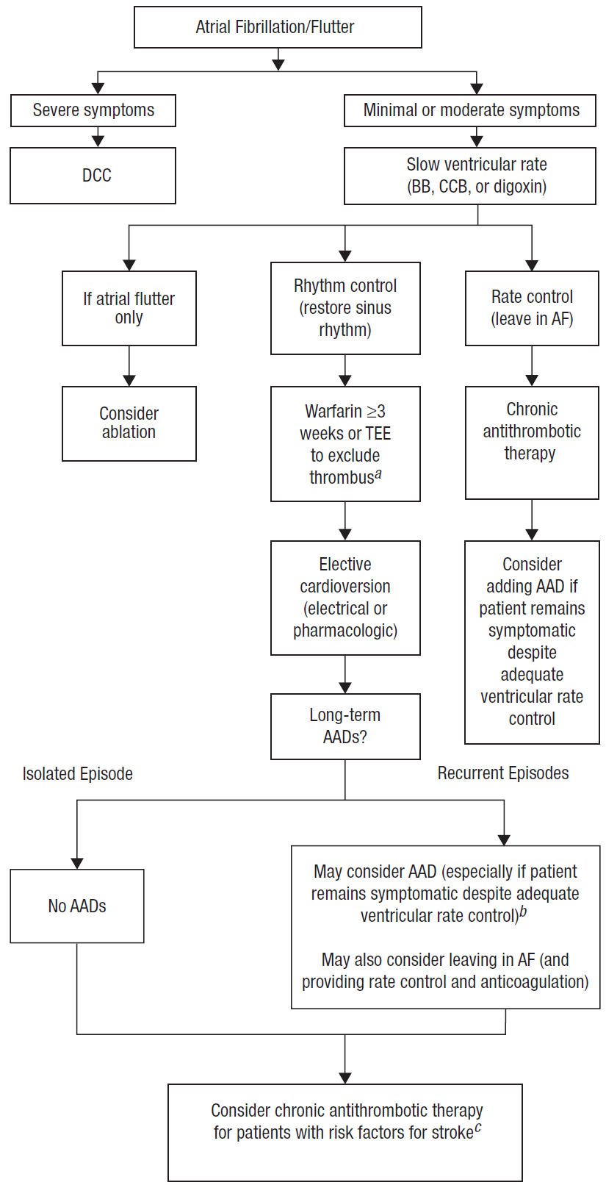
Fig: Algorithm for the treatment of atrial fibrillation (AF) and atrial flutter.

Slide 65
Paroxysmal Supraventricular Tachycardia
The choice between pharmacologic and non-pharmacologic methods for treating PSVT depends on symptom severity.
Synchronized DCC is the treatment of choice if symptoms are severe
  e.g., syncope, near syncope, anginal chest pain, severe HF
Nondrug measures that increase vagal tone to the AV node (e.g., unilateral carotid sinus massage, Valsalva maneuver) can be used for mild to moderate symptoms.
If these methods fail, drug therapy is the next option.

Slide 66
Cont…
Drugs can be divided into three broad categories:
  those that directly or indirectly increase vagal tone to the AV node
    e.g., digoxin
  those that depress conduction through slow, calcium-dependent tissue
    e.g., adenosine, β-blockers, calcium channel blockers
  those that depress conduction through fast, sodium-dependent tissue
    e.g., quinidine, procainamide, disopyramide, flecainide

Slide 67
Cont…
Adenosine has been recommended as the drug of first choice in patients with PSVT
  because its short duration of action will not cause prolonged hemodynamic compromise in patients with wide QRS complexes

Slide 68
Cont…
After acute PSVT is terminated, long-term preventive treatment is indicated
  if frequent episodes necessitate therapeutic intervention or
  if episodes are infrequent but severely symptomatic.
Serial testing of antiarrhythmic agents can be evaluated in the ambulatory setting

Slide 69
Automatic Atrial Tachycardias
Underlying precipitating factors should be corrected by
  ensuring proper oxygenation and ventilation and
  correcting acid–base or electrolyte disturbances.
If tachycardia persists, the need for additional treatment is determined by symptoms.
Patients with asymptomatic atrial tachycardia and relatively slow ventricular response usually require no drug therapy.

Slide 70
Cont…
In symptomatic patients, medical therapy can be tailored either
  to control ventricular response or
  to restore sinus rhythm.
Nondihydropyridine calcium antagonists (e.g., verapamil) are considered first-line drug therapy for decreasing ventricular response.
  DCC is ineffective and β-blockers are usually contraindicated because of coexisting severe pulmonary disease or uncompensated HF.

Slide 71
Premature Ventricular Complexes
In apparently healthy individuals, drug therapy is unnecessary
  because PVCs without associated heart disease carry little or no risk.
In patients with risk factors for arrhythmic death (recent MI, LV dysfunction, complex PVCs),
  chronic drug therapy should be restricted to β-blockers because only they have been conclusively proven to prevent mortality in these patients.

Slide 72
Ventricular Tachycardia
Acute Ventricular Tachycardia
  If severe symptoms are present, synchronized DCC should be instituted immediately to restore sinus rhythm.
  Precipitating factors should be corrected if possible.
  Patients with mild or no symptoms can be treated initially with antiarrhythmic drugs.
  IV amiodarone is now recommended as first-line therapy in this situation.
  Procainamide or lidocaine given IV is a suitable alternative.

Slide 73
Cont…
Sustained Ventricular Tachycardia
  Patients with chronic recurrent sustained VT are at extremely high risk for death
  The automatic ICD is a highly effective method for preventing sudden death due to recurrent VT or VF.

Slide 74
Cont…
Torsade de Pointes
  For an acute episode of TdP, most patients require and respond to DCC.
  However, TdP tends to often recurs rapidly after DCC.
  IV magnesium sulfate is considered the drug of choice for preventing recurrences of TdP.
  Agents that prolong the QT interval should be discontinued, and exacerbating factors (e.g., hypokalemia, hypomagnesemia) corrected.

Slide 75
Cont…
Ventricular Fibrillation
  After successful resuscitation, antiarrhythmics should be continued until the patient’s rhythm and overall status are stable.
  Long-term antiarrhythmics or ICD implantation may or may not be required.

Slide 76
Bradyarrhythmias
Sinus node dysfunction
  Treatment of sinus node dysfunction involves
    elimination of symptomatic bradycardia and possibly
    managing alternating tachycardias such as AF.
  Asymptomatic sinus bradyarrhythmias usually do not require therapeutic intervention.
  In general, long-term therapy of choice for patients with significant symptoms is a permanent ventricular pacemaker.

Slide 77
Cont…
  Drugs commonly employed to treat supraventricular tachycardias should be used with caution.
  Symptomatic carotid sinus hypersensitivity also should be treated with permanent pacemaker therapy.
  Patients who remain symptomatic may benefit from adding an α-adrenergic stimulant such as midodrine

Slide 78
Atrioventricular block :
  First degree AV block : PR interval ≥ 0.20sec
    AV nodal decrease conduction, acute myocardial infraction, enhanced vagal tone.
  Secondary block
    Mobitz I (Wenckebach) : Progressive PR prolongation until QRS complex is dropped.
    Mobitz II : Absence of QRS complex.
  Third-degree block : Absence of AV conduction.

Slide 79
Cont…
  If patients with Mobitz II or third-degree AV block develop signs or symptoms of poor perfusion (e.g., altered mental status, chest pain, hypotension, shock) associated with bradycardia or AV block,
    transcutaneous pacing should be initiated immediately.
  Atropine
    0.5 mg IV given every 3 to 5 minutes, up to 3 mg total dose should be given as the pacing leads are being placed.

Slide 80
Cont…
  Infusions of epinephrine (2 to 10 mcg/min) or dopamine (2 to 10 mcg/kg/min) can be used in the event of atropine failure.
  These agents will not help if AV block is below the AV node (Mobitz II or trifascicular AV block)
  Chronic symptomatic AV block warrants insertion of a permanent pace-maker.
  Patients without symptoms can sometimes be followed closely without the need for a pacemaker.

Slide 81
Evaluation Of Therapeutic Outcomes
The most important monitoring parameters include
  mortality (total and due to arrhythmic death)
  arrhythmia recurrence (duration, frequency, symptoms)
  hemodynamic consequences (rate, blood pressure, symptoms) and
  treatment complications (need for alternative or additional drugs, devices or surgery).

